Slide 1


Andrés de la Peña
Stratio's Cassandra Lucene index:
Geospatial use cases
Jonathan Nappée
Notes:
Hello everyone, my name is Andrés de la Peña, from Stratio, and this is Jonathan Nappée, from Nephila Capital.
Today, we are going to talk about how to indéx Geospatial data in Cassandra using Stratio's pluggable Lucene's secondary índex, and we will show some examples about how to apply these features to several Nephila's use cases.

Slide 2


Big Data Company
Certified Spark distribution
Founded in 2013
200+ employees
Offices in Madrid, San Francisco and Bogotá
2/40
Notes:
To begin with, I'd like to introduce Stratio.
Stratio is a big data company founded in 2013, that currently has more than 200 employees.
Our technical team is currently located in Madrid but we also have offices in San Francisco and Bogotá.
We focus on óffering a big data platform based on the Spark ecosystem, and we are one of the existing certified spark distributions.

Slide 3
1 | Lucene-based secondary indexes
2 | Geospatial search features
3 | Business use cases
3/40
Notes:
The presentation has three main points:
At first, a quick overview of Stratio's Lucene secondary indexes.
Then, we will review the geospatial search features of the plugin.
And, finally, Jonathan will show how these geospatial features are applied to three Nephila's business use cases

Slide 4
Lucene-based Cassandra secondary indexes
Notes:
Stratio's Lucene index is an open source implementation of Cassandra's secondary indexes based on Lucene. It was first created in 2014 as a fork of Cassandra, and it became a plugin for Apache Cassandra during last year.
It extends Cassandra index functionality to provide near real time search such as ElasticSearch or Solr, including full text search capabilities and free multidimensional, geospatial and bitemporal search.

Slide 5
Apache Lucene
General purpose search library
Created by Doug Cutting in 1999
Core of popular search engines:
Apache Nutch, Compass, Apache Solr, ElasticSearch
Tons of features:
Full-text search, inequalities, sorting, geospatial, aggregations…
Rich implementation:
Multiple index structures, smart query planning, cool merge policy…
5/40
Notes:
Rather than building our own index structures, we chose using Apache Lucene as the underlying technology for several reasons:
- It is a proven stable and fast índexing solution.
- It has a lot of interesting features, such as boolean queries, range queries or relevance search.
- Solr and ElasticSearch are successful examples of distributed search éngines built on top of Lucene.
- We also like that Lucene is just a small library that can be embedded directly in Cassandra, and not an external service.
- Finally, it is an Apache project, like Cassandra, fully open source and with a large user community.

Slide 6
A Lucene-based C* 2i implementation
Each node indexes its own data
Keep P2P architecture
Distribution managed by C*
Replication managed by C*
Just a single pluggable JAR file
C* node
Lucene index
JVM
custom query handler
C* node
C* node
CLIENT
Lucene index
Lucene index
JVM
JVM
6/40
Notes:
Here we can see how the integration between Cassandra and Lucene works.
There is a Lucene índex embedded in each Cassandra node, so each node indexes its own data.
This way, Lucene doesn't have anything to do with distribution and replication, which are responsibility of Cassandra.
The peer-to-peer architecture is preserved, so each node is able to coordinate any query. So, no master nodes or external coordinators are required.
A cool feature of the Lucene index is that it allows to paginate over rows sorted with a different order than the defined by the partitioner. Sorted pagination is possible thanks to a custom CQL query handler able to intercept and rewrite the Cassandra internal read commands.
If we are performing one of these top-k queries, then all the involved nodes will be queried in a parallel fashion. Otherwise, nodes will be sequentially scanned until we find the requested results.

Slide 7
Creating Lucene indexes
Built in the background
Dynamic updates
Immutable mapping schema
Many columns per index
Many indexes per table
CREATE TABLE tweets (
user text,
date timestamp,
message text,
hashtags set<text>
PRIMARY KEY (user, date));
CREATE CUSTOM INDEX tweets_idx ON tweets()
USING 'com.stratio.cassandra.lucene.Index'
WITH OPTIONS = {
'refresh_seconds': '1',
'schema': '{fields : {
user : {type: "string"},
date : {type: "date", pattern: "yyyy-MM-dd"},
message : {type: "text", analyzer: "english"},
hashtags: {type: "string"}}}'};
7/40
Notes:
Now we are going to see how Lucene indexes are created using the Cassandra Query Language.
Let's say that we have a table containing tweets. We store the tweet ID, its creation date, the message body, the user ID and the user name.
Then, we create the índex in CQL specifying the Stratio índex class and the índexing properties.
We specify an índex readers refresh of one second, and which columns are going to be índexed and how.
The creation date will be índexed as a date, using a pattern composed by year, month, and day, defining a precision of days
The message field will be treated as English tokenized text
And the user ID and the hashtags will be indexed as untokenized text.

Slide 8
Querying Lucene indexes
Custom JSON syntax
Multiple query types
Multivariable conditions
Multivariable sorting
Separate filtering and relevance queries
SELECT * FROM tweets WHERE expr(tweets_idx, '{
filter: {
must: {type: "phrase", field: "message", value: "cassandra is cool"},
not: {type: "wildcard", field: "hashtags", value: "*cassandra*"}
},
sort: {field: "date", reverse: true}
}') AND user = 'adelapena' AND date >= '2016-01-01';
8/40
Notes:
Here we have an example showing how to do searches using the Lucene índex.
It includes filtering, negative filtering, sorting and routing.
We embed the Lucene index JSON syntax inside Cassandra Query Language using the recently created clause for custom expressions.
The JSON Lucene expression specifies that we are searching for all the tweets containing the phrase 'cassandra is cool'.
We also require that the matched tweets must not be labeled with the hashtag 'cassandra'.
Additionally, results should be returned sorted by descending creation date.
Also, we add some CQL regular clauses specifying that we are only interested in tweets created by a specific user during this year.
'user' is the partition key of the table, so the search will be routed to a single node, avoiding the performance problems of unrestricted secondary indexes queries.
So, with this example we can see how the Lucene índex allows to perform quite complex searches.

Slide 9
Java query builder
Available for JVM languages: Java, Scala, Groovy…
Compatible with most Cassandra clients
import static com.datastax.driver.core.querybuilder.QueryBuilder.*; import static com.stratio.cassandra.lucene.builder.Builder.*;
{…}
String search = search().filter(phrase("message", "cassandra is cool")) .filter(not(wildcard("hashtags", "*cassandra*"))) .sort(field("date").reverse(true)) .build(); session.execute(select().from("tweets") .where(eq("lucene", search)) .and(eq("user", "adelapena")) .and(lte("date", "2016-01-01")));
9/40
Notes:
The index is distributed together with a fluent Java query builder that allows to programmatically build index related JSON queries.
The built Lucene index clauses are managed as plain strings, so the query builder should be compatible with most JVM-based Cassandra clients, including the popular DataStax Java driver.
This is useful because it can be easily integrated in your existing programs.
In this example, we show how to use the query builder to write the query that we saw in the previous slide. The produced JSON string can be easily used as a clause of the query builder provided by the DataStax Java driver.

Slide 10
Apache Spark integration
Compute large amount of data
Maximizes parallelism
Filtering push-down
Avoid full-scan
spark worker
C* node
Lucene index
JVM
spark master
spark worker
spark worker
C* node
C* node
Lucene index
Lucene index
JVM
JVM
10/40
Notes:
A very important feature of our indexes is that they can be combined with MapReduce frameworks, especially with Spark.
The usage of Lucene predicates with Spark allows to filter the rows at the data database level.
This way, we can retrieve from Cassandra only the information that we need.
It avoids the unnecessary reads produced by the usual systematic full table scan.
And, it can reduce the amount of data to be processed, speeding up the jobs.
As you know, in this kind of deployments there is a Spark Worker running in each Cassandra node.
This is done in order to parallelize jobs preserving data locality.
Since each node indexes its own data, the locality is guaranteed when using Lucene indexes.

Slide 11
Geospatial search features
Notes:
Now we are going to talk about the spatial search capabilities that the Lucene plugin adds to Cassandra.
These features are based on the Lucene speishal module and on the Java Topology Suite.
A small set of these spatial capabilities was presented during our talk in the last Cassandra Summit. During this year, the number of spatial features has grown significantly, and Nephila has had an important role in this.

Slide 12
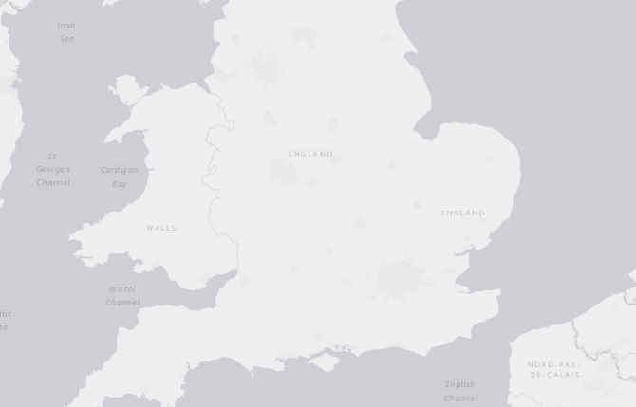
Geo point mapper
CREATE TABLE restaurants(
name text PRIMARY KEY,
stars bigint,
lat double,
lon double);
CREATE CUSTOM INDEX restaurants_idx
ON restaurants (lucene)
USING 'com.stratio.cassandra.lucene.Index'
WITH OPTIONS = {
'refresh_seconds' : '1',
'schema' : '{
fields : {
location : {
type : "geo_point",
latitude : "lat",
longitude : "lon"
},
stars: {type : "integer" }
}
}
'};
14/40
Notes:
Here we have an example to show how to indéx latitude-longitude points stored in Cassandra using CQL.
Imagine an application where we want to find restaurants around you.
In this example, the table (on the left) contains the restaurant name, and its location.
There isn`t a native point type in Cassandra, so we will use two numeric columns, latitude and longitude, to represent the location. Also a tuple or an UDT could have been used.
Then, we create the índex using the statement on the right.
In order to indéx the location, we will add a 'geo_point' mapper named 'location'.
With this mapping we must specify which columns, in the indexed table, store the latitude and the longitude.
We may combine the geo point mapper with any other non-geospatial mapper.
For example, we indéx the 'stars' column as an integer.

Slide 13
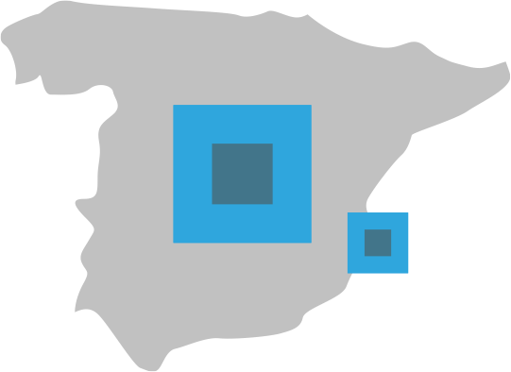
Bounding box search
SELECT * FROM restaurants
WHERE lucene =
'{
filter :
{
type : "geo_bbox",
field : "location",
min_latitude : 40.425978,
max_latitude : 40.445886,
min_longitude : -3.808252,
max_longitude : -3.770999
}
}';
15/40
Notes:
Now that the user locations have been índexed, we can start searching for geospeishal data.
The simplest type of query that we have is Bounding box.
In this example, we search for restaurants placed inside the visible screen of an hypothetical mobile application.
To define the bounding box, we specify, in the query, the minimum and maximum latitude and longitude values.
This way, we will collect all the restaurants within the specified coordinates

Slide 14
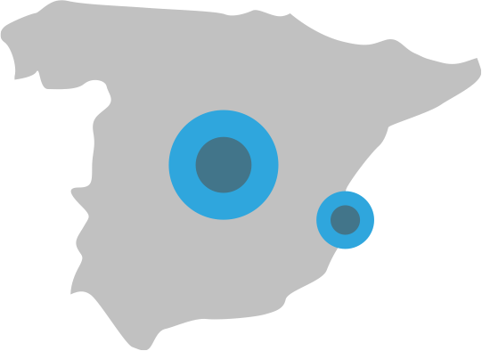
Distance search
SELECT * FROM restaurants
WHERE lucene =
'{
filter :
{
type : "geo_distance",
field : "location",
latitude : 40.443270,
longitude : -3.800498,
min_distance : "100m",
max_distance : "2km"
}
}';
16/40
Notes:
Another possible query is to search for restaurants placed inside a specific distance range from a fixed point.
For this, we must specify the latitude and the longitude of the reference point, and the desired distance range.
Max distance is mandatory, whereas min distance is optional.
Along with the distance value we can specify a distance unit.
In our example, we search for restaurants located at least one hundred meters away but no more than two kilometers away from our position.

Slide 15

Distance sorting
SELECT * FROM restaurants
WHERE lucene =
'{
sort:
{
type : "geo_distance",
field : "location",
reverse : false,
latitude : 40.442163,
longitude : -3.784519
}
}' LIMIT 10;
17/40
Notes:
Additionally, it is also possible to sort the results of any search by their distance to a specific location.
In the example we request the restaurants closest to the user's location.
The 'reverse' attribute controls whether the order should be ascending or descending, that is, if we are going to retrieve the closest or the farthest locations.
Finally, we use the CQL limit clause to select only the ten closest restaurants.
Although pure sorting queries are perfectly possible, it is usually a good idea to combine sorting with any other filter. This way, we will reduce the number of matched rows, and so the number of locations to be sorted.

Slide 16
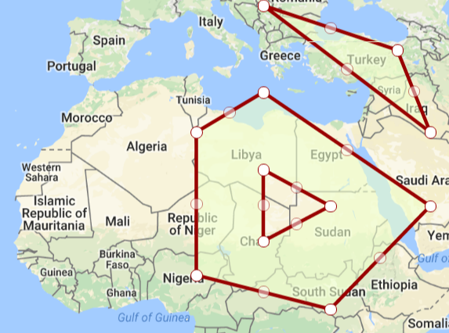
Indexing complex geospatial shapes
Points, lines, polygons & multiparts
JTS index-time transformations
CREATE TABLE places(
id uuid PRIMARY KEY,
shape text -- WKT formatted
);
CREATE CUSTOM INDEX places_idx ON places()
USING 'com.stratio.cassandra.lucene.Index'
WITH OPTIONS = {
'schema': '{
fields: {
shape: {
type: "geo_shape",
max_levels: 15,
transformations: []
}
}
}'
};
18/40
Notes:
One of the most exciting Lucene features, that we have recently added, is the ability to index complex geographical shapes, and not only latitude-longitude points.
The shapes should be stored in Cassandra in text columns in the WKT format. WKT is a popular markup language able to represent points, line strings, polygons and their muliparts.
The indexing is based in the JTS library and its integration with Spatial4j. Although WKT is the only currently supported format, we plan to add support for other popular formats such as GeoJSON.
In the example we can see a table storing places, where the text column 'shape' stores a WKT geographical shape. We create a Lucene index that maps this column as a geographical shape, specifying the maximum number of levels in the geohash search prefix tree.
It is also possible to specify a sequence of geometric transformations to be sequentially applied to the shape before indexing it. Now we will see some examples to demonstrate the utility of these transformations.

Slide 17
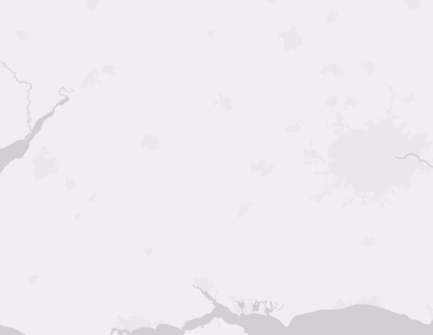
Index-time shape transformations
Example: Index only centroid of shapes
CREATE CUSTOM INDEX places_idx ON places()
USING 'com.stratio.cassandra.lucene.Index'
WITH OPTIONS = {
'refresh_seconds': '1',
'schema': '{
fields: {
shape: {
type: "geo_shape",
max_levels: 15,
transformations: [{type: "centroid"}]
}
}
}'
};
19/40
Notes:
One of the available index-time transformations is calculating the centroid of the indexed shape. In these example the indexed table stores polygons but we are only interested in indexing the center of the shapes.

Slide 18
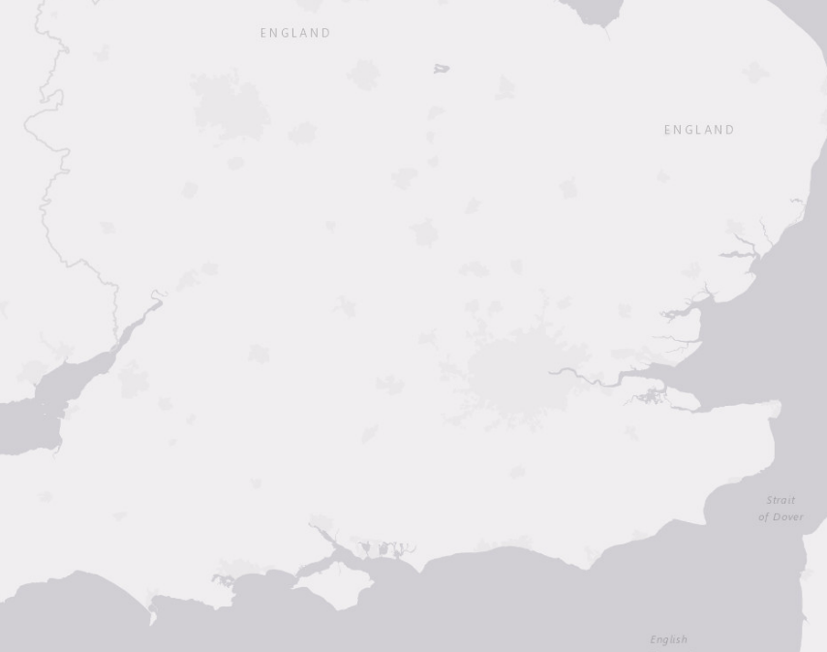
Index-time shape transformations
Example: Index 50 km buffer zone around shapes
CREATE CUSTOM INDEX places_idx ON places()
USING 'com.stratio.cassandra.lucene.Index'
WITH OPTIONS = {
'schema': '{
fields: {
shape: {
type: "geo_shape",
max_levels: 15,
transformations: [{
type: "buffer",
min_distance: "50km"}]
}
}
}'
};
20/40
Notes:
Another very useful transformation is indexing a buffer around the initial shape. In the example we are applying a 'buffer' transformation to index the region which is 50km around the stored shape.
This transformation could be used, for example, for storing the coverage area of a set of antennas given their lat-lon locations. It could also be used for storing the area around roads or borders defined as line strings.

Slide 19
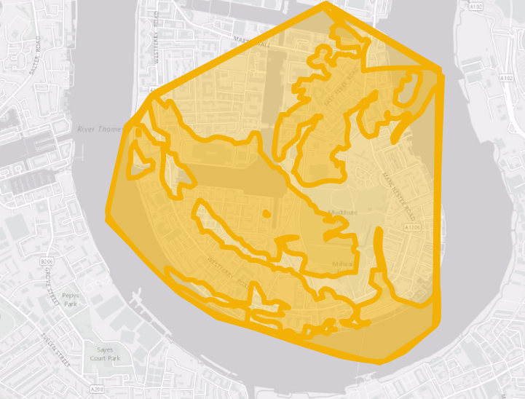
Index-time shape transformations
Example: Index the convex hull of the shape
CREATE CUSTOM INDEX places_idx ON places()
USING 'com.stratio.cassandra.lucene.Index'
WITH OPTIONS = {
'refresh_seconds': '1',
'schema': '{
fields: {
shape: {
type: "geo_shape",
max_levels: 8,
transformations:
[{type: "convex_hull"}]
}
}
}'
};
21/40
Notes:
Index size and performance greatly depends on the complexity of the indexed shapes. Shapes with a lot of points and precision decimals will produce many terms in the search tree. This increases the size of the index and reduces performance. So, if your use case allows it, it could be interesting to use transformations to simplify the indexed shapes. Both centroid and bounding box are typical transformations to do this. Convex hull can also be an interesting, more accurate, precision reducer.
In this example we show how convex hull transformation is used to reduce a complex shape with more than two thousand points, to a simple polygon with only eight points, dramatically increasing both indexing and searching performance.

Slide 20
Search by geo shape
Can search points and shapes using shapes
Operations define how you search: Intersects, Is_within, Contains
Can use transformations before searching
Bounding box
Buffer
Centroid
Convex Hull
Difference
Intersection
Union
22/40
Notes:
The indexed polygons can be retrieved by the previously shown bounding box and distance searches.
We have also recently added a geo-shape search type that allows to search for shapes that are related with other shapes (and points). The currently supported spatial relations are intersects, is within, and contains.
It is also possible to apply transformations to the shapes used in the search. This allows to build complex shapes in search-time from other WKT shapes.

Slide 21
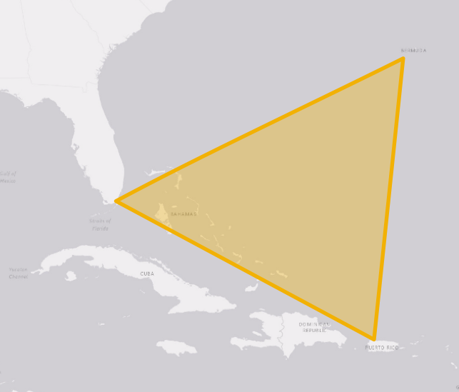
Geo Search
Example: search within a polygon
SELECT * FROM cities
WHERE expr(cities_index, '{
filter: {
type: "geo_shape",
field: "place",
operation: "is_within",
shape: {
type: "wkt",
value: "POLYGON((-0.07 51.63,
0.03 51.54,
0.05 51.65,
-0.07 51.63))"
}
}
}';
23/40
Notes:
In this example we are searching for all the indexed shapes within a triangle. In this case we search for places within the Bermuda Triangle. Please note how we define both, the spatial operation to be applied, and the format of the search shape, which is WKT.
In addition, we can recursively define the search shape as transformations of other shapes, as we will see in the Nephila's business use cases that Jonathan will show us.

Slide 22
Business use cases
Notes:
Thank you Andres, I am Jonathan Nappée, I have been working with Nephila Capital for a year now in the Bermuda office.
I first started talking to Andres while trying to solve some of our geospatial challenges with Stratio Lucene index in Cassandra.
It already contained basic point indexing and distance search features but I had more complex indexing and search cases to implement.
It turned out Andres also wanted to improve this aspect of the index.
So when we met in London in February we very quickly came up with this idea of transformations.
I want to show you now a couple of simplified examples how features could be used in the context of Nephila.

Slide 23
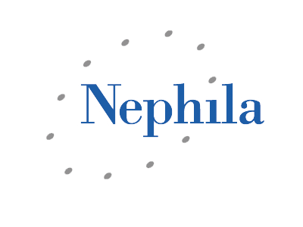
Investment fund with large exposures to natural catastrophe insurance on properties
Many geographical data sets:
properties details
natural catastrophe event data
Hurricane tracks and affected zones
Earthquakes impact zones
Risks and portfolios
23/40
Notes:
To begin with, let me introduce Nephila Capital and briefly explain it’s business.
We are an investment fund that specializes in natural catastrophe property insurance. That means we deal with house or building insurances against hurricane, earthquakes or flood kind of disaster.
As you can imagine we manipulate many different kinds of geospatial data sets, from properties we insure to the natural catastrophes impacts.

Slide 24
Use cases data set
We indexed all the US census blocks shapes from the Hazus Database
https://www.fema.gov/hazus
These blocks contain revenue and building stats that are useful for pricing insurance premiums and potential losses
Average revenue
Number of stories
Some of them are very complex
First attempt with convex hull
Composite indexing strategy with ±2km geohash and doc values in borders
We also indexed all police and firestations in the US
24/40
Notes:
Let me explain now the setup for these examples.
We started by indexing all US census blocks, that is to say shapes of blocks of buildings, inside a Cassandra cluster.
Some of the block shapes are very complex and can contain hundreds of points and multiple polygons.
To improve the efficiency we first tried indexing the convex hull but then switched to a composite indexing strategy. I’ll go into more details on this strategy in a few slides.
We also indexed all US fire and police stations locations.

Slide 25
Use cases data set
CREATE TABLE blocks (
state text,
bucket int,
id int,
area double,
type text,
income_ratio double,
latitude double,
longitude double,
shape text,
...
lucene text,
PRIMARY KEY ((state, bucket), id)
);
CREATE CUSTOM INDEX block_idx ON blocks(lucene)
USING 'com.stratio.cassandra.lucene.Index'
WITH OPTIONS = {
'refresh_seconds': '1',
'schema': '{
fields : {
state : {type: "string"},
type : {type: "string"},
...
center: {type: "geo_point",
max_levels: 11,
latitude: "latitude",
longitude: "longitude"},
shape : {type: "geo_shape",
max_levels: 5}
}
}'};
25/40
Notes:
This is how the blocks table looks like.
Each block contains its shape, centroid location, state income ratio and other information.
We then indexed the different fields and in particular the block’s shapes.

Slide 26
Use cases data set
Analogous indexing for police and fire stations tables
CREATE TABLE fire_stations(
state text,
id text,
city text,
latitude double,
longitude double,
shape text,
...
lucene text,
PRIMARY KEY (state, id)
);
CREATE TABLE police_stations(
state text,
id text,
city text,
latitude double,
longitude double,
shape text,
...
lucene text,
PRIMARY KEY (state, id)
);
26/40
Notes:
This is how the stations table looks like.
Each station contains its shape, centroid location, state, city and other information.
We then indexed the different fields and in particular the locations.

Slide 27
Composite spatial strategy
Meant for indexing complex polygons
Two spatial strategies combined
GeoHash recursive prefix tree for speed
Serialized doc values for accuracy
Reduced number of geohash terms
Doc values only for polygon borders
David Smiley blog post:
http://opensourceconnections.com/blog/2014/04/11/indexing-polygons-in-lucene-with-accuracy
27/40
Notes:
Before I start showing the examples, let me explain a bit more the composite indexing strategy.
This strategy uses two separate index structures, one to achieve speed and other to achieve acuracy. The first search structure is a geohash recursive prefix tree, usually with low precision. This geohash tree is used to quickly discard most of not matching documents. Then, the second search structure, which is a simple covering index, is used to discard the false positives produced by the geohash tree.
This composite approach allows to quickly retrieve results with complete accuracy while keeping the index relatively small, and it is specially usefull with our dataset, which is composed by very complex polygons that would produce too much terms in a regular high-accuracy geohash search tree.

Slide 28
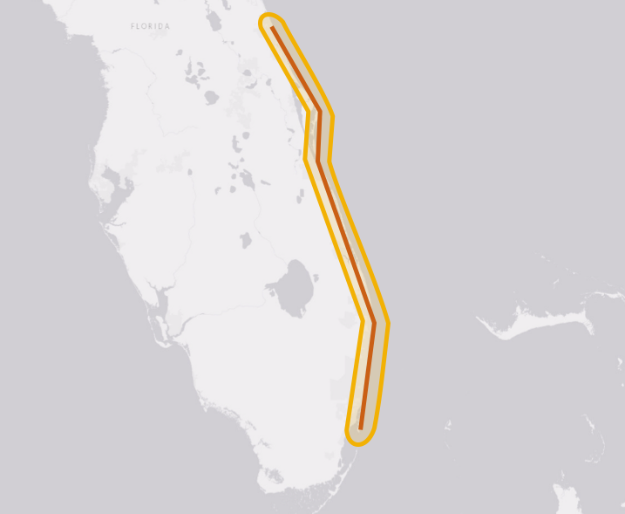
Use cases: Search blocks in a shape
We search which census blocks intersect with a shape
SELECT * FROM blocks
WHERE expr(blocks_index, '{
filter: {
type: "geo_shape",
field: "shape",
operation: "intersects",
shape: {
type: "buffer",
max_distance: "10km",
shape: {
type: "wkt",
value: "LINESTRING -80.90 29.05...)"
}
}
}
}';
28/40
Notes:
For our first use case we want to perform a search of blocks that intersect with a given shape.
This is an important feature for us as the most damaged properties when a hurricane landfall happens are usually the ones closest to the shore.
We can index the coast line but we usually want to see different buffer zones, the 1km, the 5 km and so on. So we use this buffer transformation to give us this flexibility.

Slide 29
Use cases: Search blocks far from police and fire stations
Proximity to police and fire stations can have an impact on damage when natural catastrophe event happens
We can use this information to search for blocks in our portfolio that are more than 8 miles from any station to highlight their risk
29/40
Notes:
In this second use case, we are interested in finding which blocks are far from any police or fire station.
A property far from a fire station will probably on average suffer more damage from a fire than one close to a station.
Thus we can use that information in evaluating the insurance risk.
We consider that the beyond an 8 miles radius the fire station response becomes longer and thus less efficient.

Slide 30
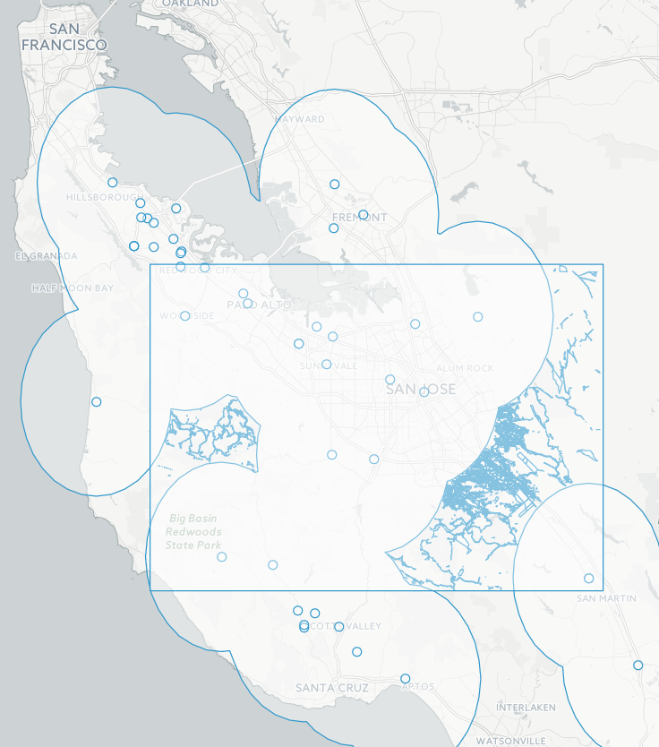
Use cases: Search blocks far from fire stations
SELECT * FROM fire_stations WHERE lucene = '{
filter : {
type: "geo_shape",
field: "centroid",
shape: {value: "POLYGON(…)"}}
}';
SELECT * FROM blocks WHERE lucene = '{
filter : {
must: {
type: "geo_shape",
field: "shape ",
shape: {value: "POLYGON(…)"}},
not: {
type: "geo_shape",
field: "shape",
shape: {
type: "buffer",
max_distance: "8mi",
shape: {value: "MULTIPOINT(…)"}}}
}}';
30/40
Notes:
So we define a rectangular zone of interest in which we find all the fire stations.
We then build the 8 miles radius shapes from the fire stations and merge them.
Finally we search for all blocks in the rectangular zone, not within the stations safer zone.

Slide 31
Use cases: Find which blocks are affected by a moving hurricane and their maximum wind speed exposures
If we are modelling a hurricane we end up with a changing shape every 6 hours, with different location and wind speeds
We want to find for each state which blocks are hit and at which maximum wind speed
We use transformations to represent the moving hurricane and within that the different wind speeds
31/40
Notes:
For the last use case we consider that a Hurricane just hit the US, in this case we use Hurricane Katrina’s example.
We know every 6 hours the location of the hurricane and two zones, the larger zone with medium wind speeds and the smaller zone with highest wind speeds.

Slide 32
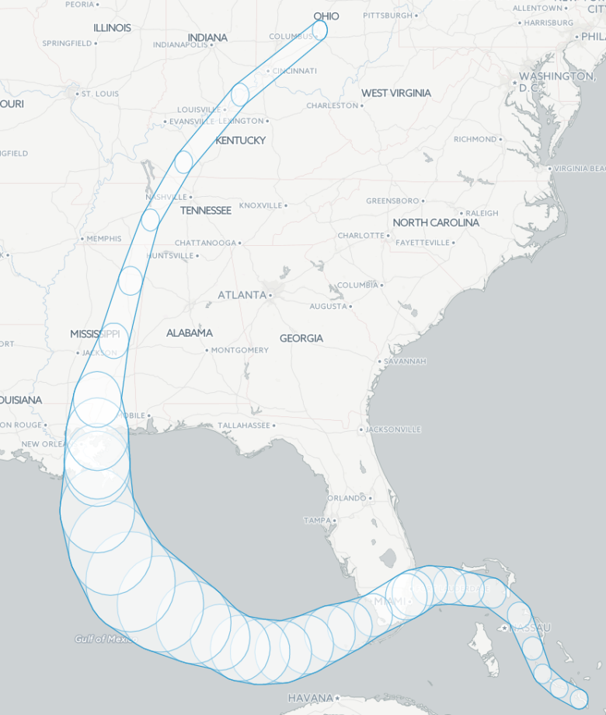
Use cases: Blocks affected by a moving hurricane
SELECT * FROM blocks WHERE expr(idx, '{
filter : {
type: "geo_shape",
field: "shape",
shape: {
type: "union",
shapes: [{
type: "convex_hull",
shape: {
type: "union",
shapes: [
{type: "buffer",
max_distance: "6mi",
shape: {value: "POINT(…)"}},
{type: "buffer",
max_distance: "3mi",
shape: {value: "POINT(…)"}}
]},
...
]
}
}}';
Notes:
In this example we search for all the blocks in our portfolio of insurance that are hit by the hurricane.
So we merge the two wind speed zones together, further merge with all the other shapes of the hurricane at different times and then look for the blocks inside.

Slide 33
Conclusions

Slide 34
Conclusions
New pluggable geospatial features in Cassandra
Complex polygon search
Geometrical transformations API
Can be combined with other search predicates
Compatible with MapReduce frameworks
Preserves Cassandra's functionality
34/40

Slide 35

It's open source
github.com/stratio/cassandra-lucene-index
Published as plugin for Apache Cassandra
Apache License Version 2.0
35/40
Notes:
And last but not least, our implementation is completely open source.
It is published under the Apache License and it can be found at GitHub.
We encourage you to take a look at it, and, of course, any contribution is more than welcomed.

Slide 36




THANK YOU
UNITED STATES
EUROPE
Tel: (+1) 408 5998830
Tel: (+34) 91 828 64 73
contact@stratio.com
www.stratio.com
Notes:
Thanks for your attention! Any questions?

